Slide 1
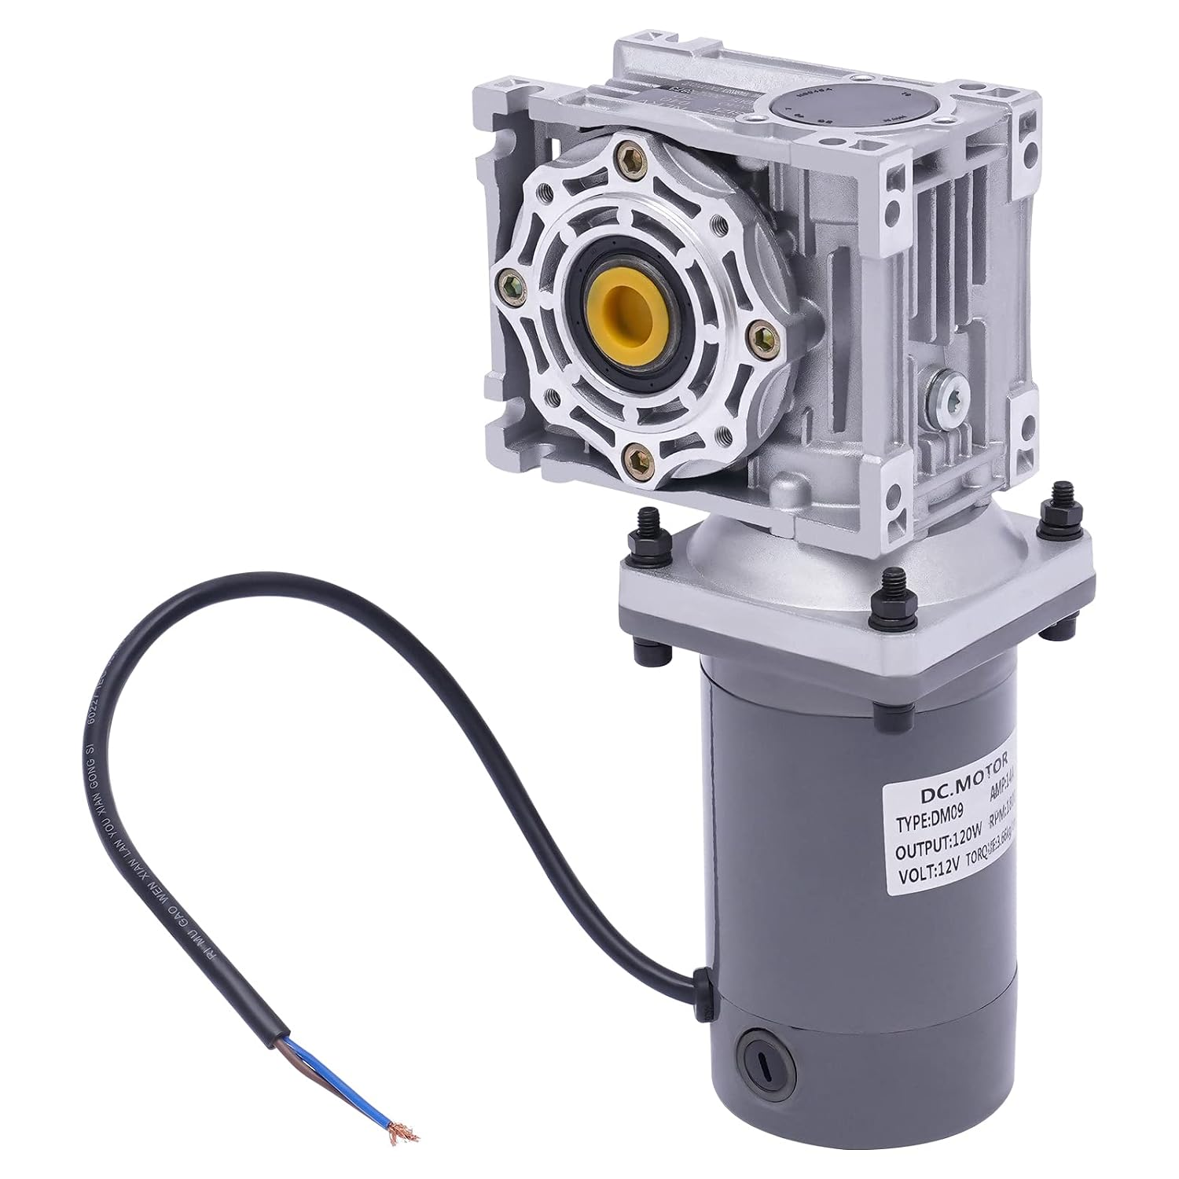
Practical DC Motors and Geared Motors
AME5011
Akbar QAMAR
Notes:
Audience: Mechanical engineering students working on practical mechatronic systems, including the IMechE pipe-climber challenge.
Delivery: Two 120-minute classes. An optional extension at the end can take delivery to approximately 4.5-5 hours.
Focus: Brushed permanent-magnet DC motors and the geared motor assemblies commonly used in student prototypes. Brushless motors are introduced only to distinguish technologies and avoid misidentifying them.
Teaching approach: Connect each electrical quantity to an observable mechanical result. Use the actual motor, gearbox, driver and power supply students will use wherever possible. Insert local component photographs, manufacturer graphs, circuit diagrams, rig images and measured class data where indicated.

Slide 2
The Types
Brushed DC Motors
Brushless DC Motors
Servo Motors
Geared Motors

Slide 3
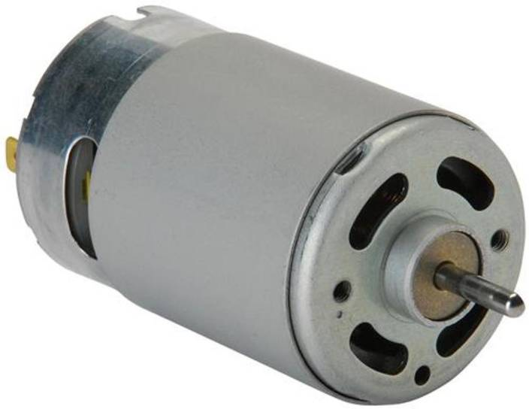
Scope
From electrical input to useful mechanical work
Brushed permanent-magnet DC motors
Geared motor assemblies
Measurement, selection, control and thermal limits
Application context: small vehicles, rollers, winches and pipe-climbers
Notes:
Begin with a real motor in hand. Ask students to identify what they can see and what they think is hidden inside. Avoid beginning with equations; return to the same motor throughout both classes.

Slide 4

The Motor That Spins but Does Not Work
A motor is connected to a battery and its shaft spins freely. Once attached to the mechanism, the vehicle will not start moving.
Possible causes:
The motor cannot provide enough torque at the required speed.
The gear ratio or wheel radius is unsuitable.
The mechanism is binding or the load is larger than expected.
The supply voltage sags or a driver current limit is reached.
The contact surface slips, so motor torque does not become useful drive force.
The motor starts but overheats during repeated operation.
Notes:
Opening question: What would you measure first, and what result would help distinguish these causes?
Speaker notes: Collect hypotheses without immediately judging them. Return to the list during the selection challenge. Emphasise that a motor is part of a drive system, not a stand-alone answer to a mechanical problem.

Slide 5

What would you blame first, and what result would help distinguish these causes?
Notes:
Opening question: What would you measure first, and what result would help distinguish these causes?
Speaker notes: Collect hypotheses without immediately judging them. Return to the list during the selection challenge. Emphasise that a motor is part of a drive system, not a stand-alone answer to a mechanical problem.

Slide 6
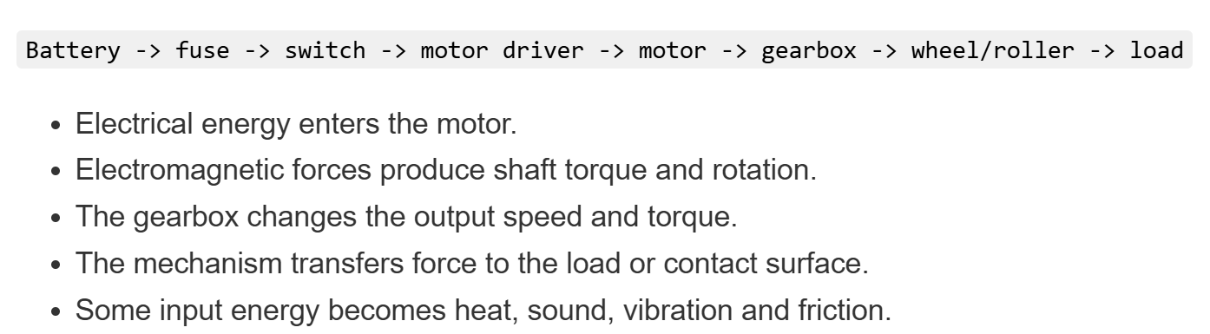
Notes:
Ask students to locate where a current measurement, shaft-speed measurement, temperature measurement and force measurement could be made. Note that the driver controls motor current; the controller should not directly supply motor current from a GPIO pin.

Slide 7

What Does a Motor Convert?
Rotational mechanical output power
Check: If the shaft is stalled while current is flowing, where is the electrical input energy going?

Slide 8
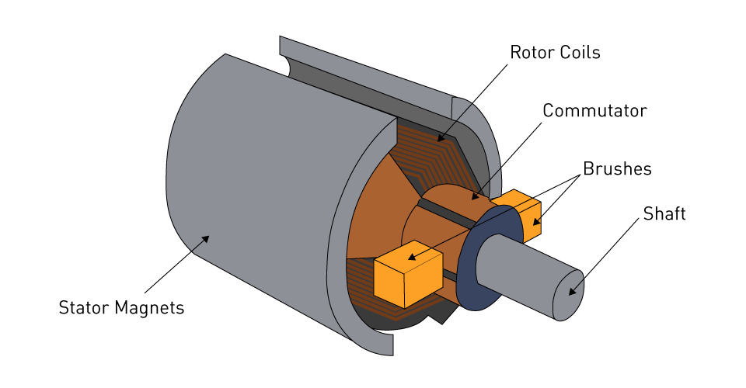
Notes:
Small can motors typically use permanent magnets in the stator. Larger brushed motors may use wound field coils. Keep the presentation focused on the permanent-magnet type students are likely to handle.

Slide 9
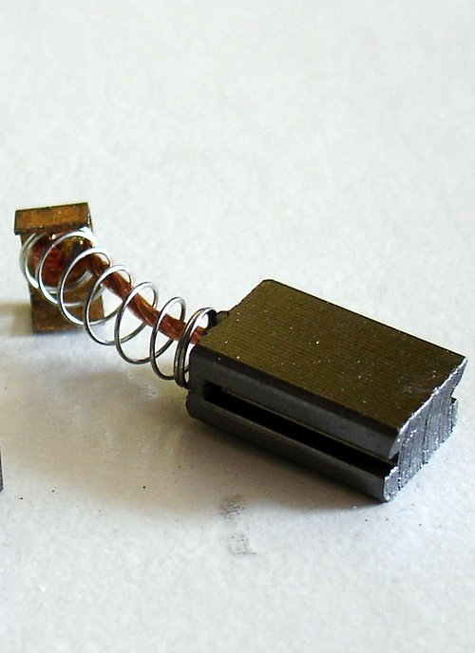
Brushes: Useful, Wearable, Noisy
Brush contact makes the design simple to drive and reverse.
Brushes and commutator wear with use; brush dust and contact condition matter.
Switching can produce electrical noise and visible sparking.
Contact resistance contributes to voltage drop and heating.
Brush condition, commutator condition, speed, current and environment affect service life.
Notes:
Avoid generalising lifespan without a particular motor specification. Some small motors are designed as low-cost, limited-life components; others are serviceable. Confirm the actual product construction and rating.

Slide 10
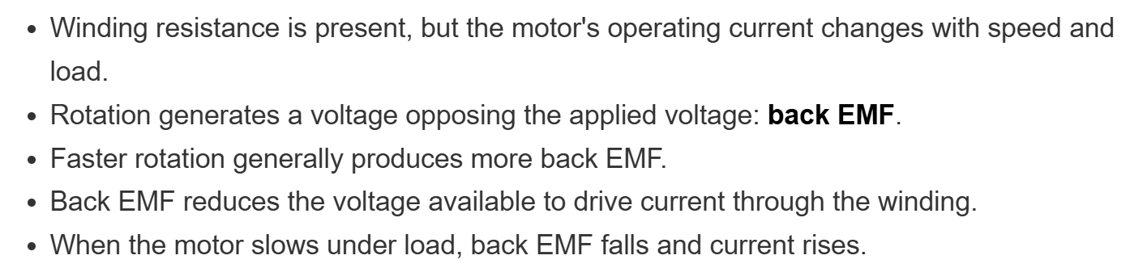
A Brushed Motor Is Not a Fixed Resistor
Notes:
This is the key idea that connects mechanical load to electrical current. The motor is an electromechanical energy converter; its apparent electrical behaviour changes as its speed changes.

Slide 11
What Makes the Rotor Turn?
Current through a conductor creates a magnetic field.
A current-carrying conductor in the stator magnetic field experiences a force.
Forces on conductors around the armature create a turning moment, or torque.
Reversing the current reverses the force direction and motor rotation.
Reversing both supply polarity and field polarity would leave torque direction unchanged in a separately excited motor; a permanent-magnet field does not reverse with the supply.
Notes:
Students do not need a detailed derivation of the motor force law for this session. The practical mental model is that field strength and armature current set the electromagnetic force, while the geometry sets the resulting torque.

Slide 12
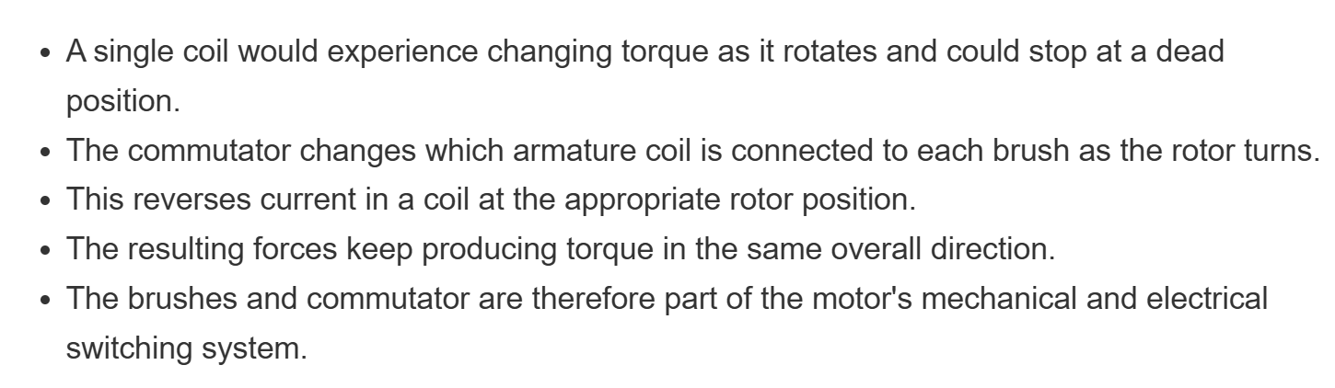
Why the Commutator Matters
Notes:
Explain commutation as mechanical switching. Avoid implying that current in the whole motor simply reverses every half-turn; the switched coil connections produce the continuing torque.

Slide 13
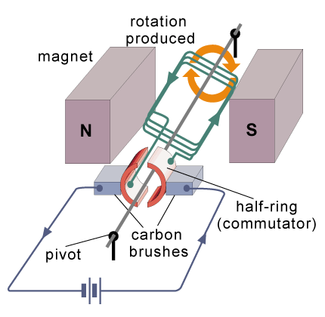

Slide 14
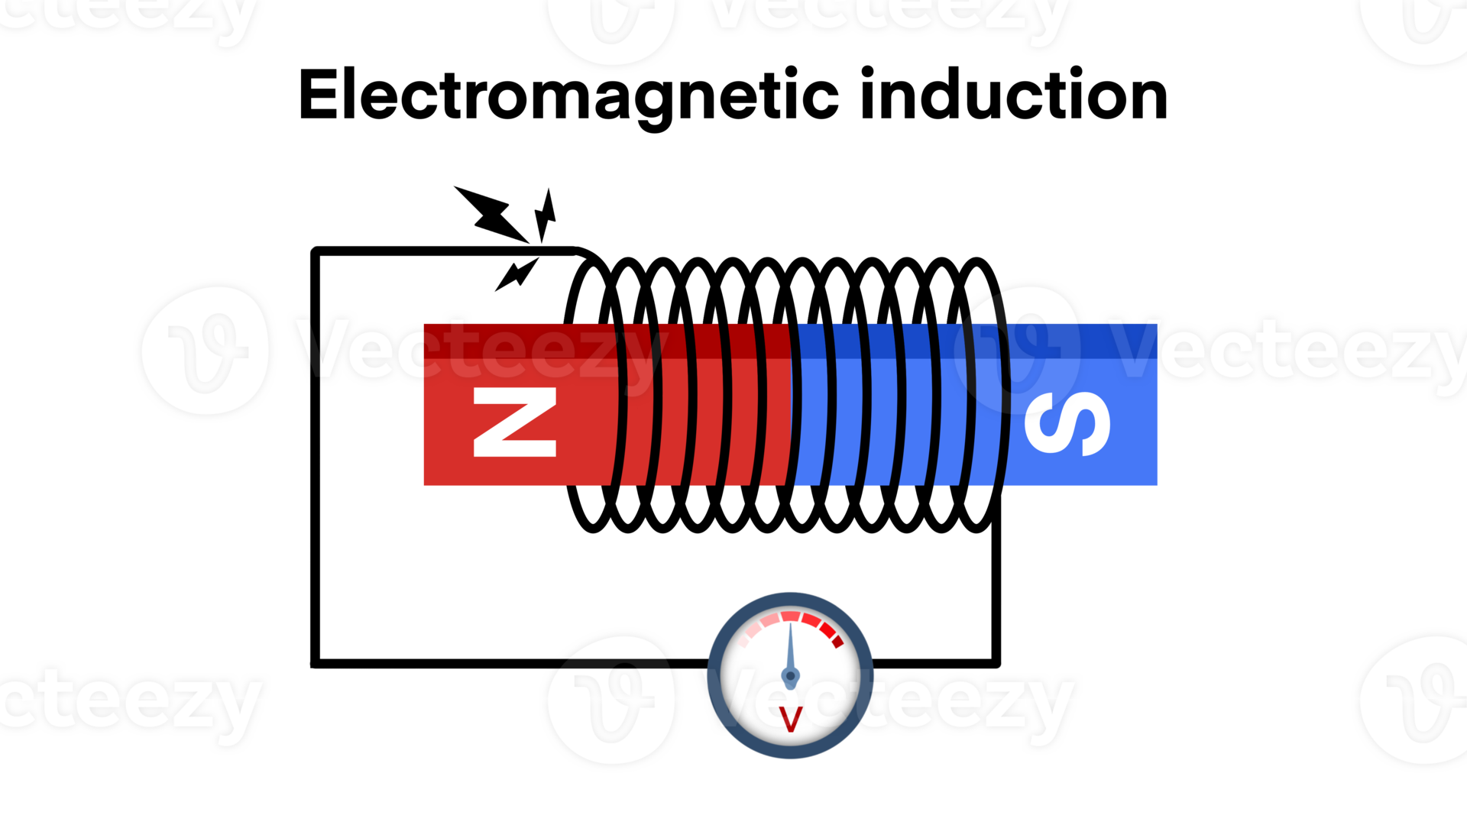

Slide 15
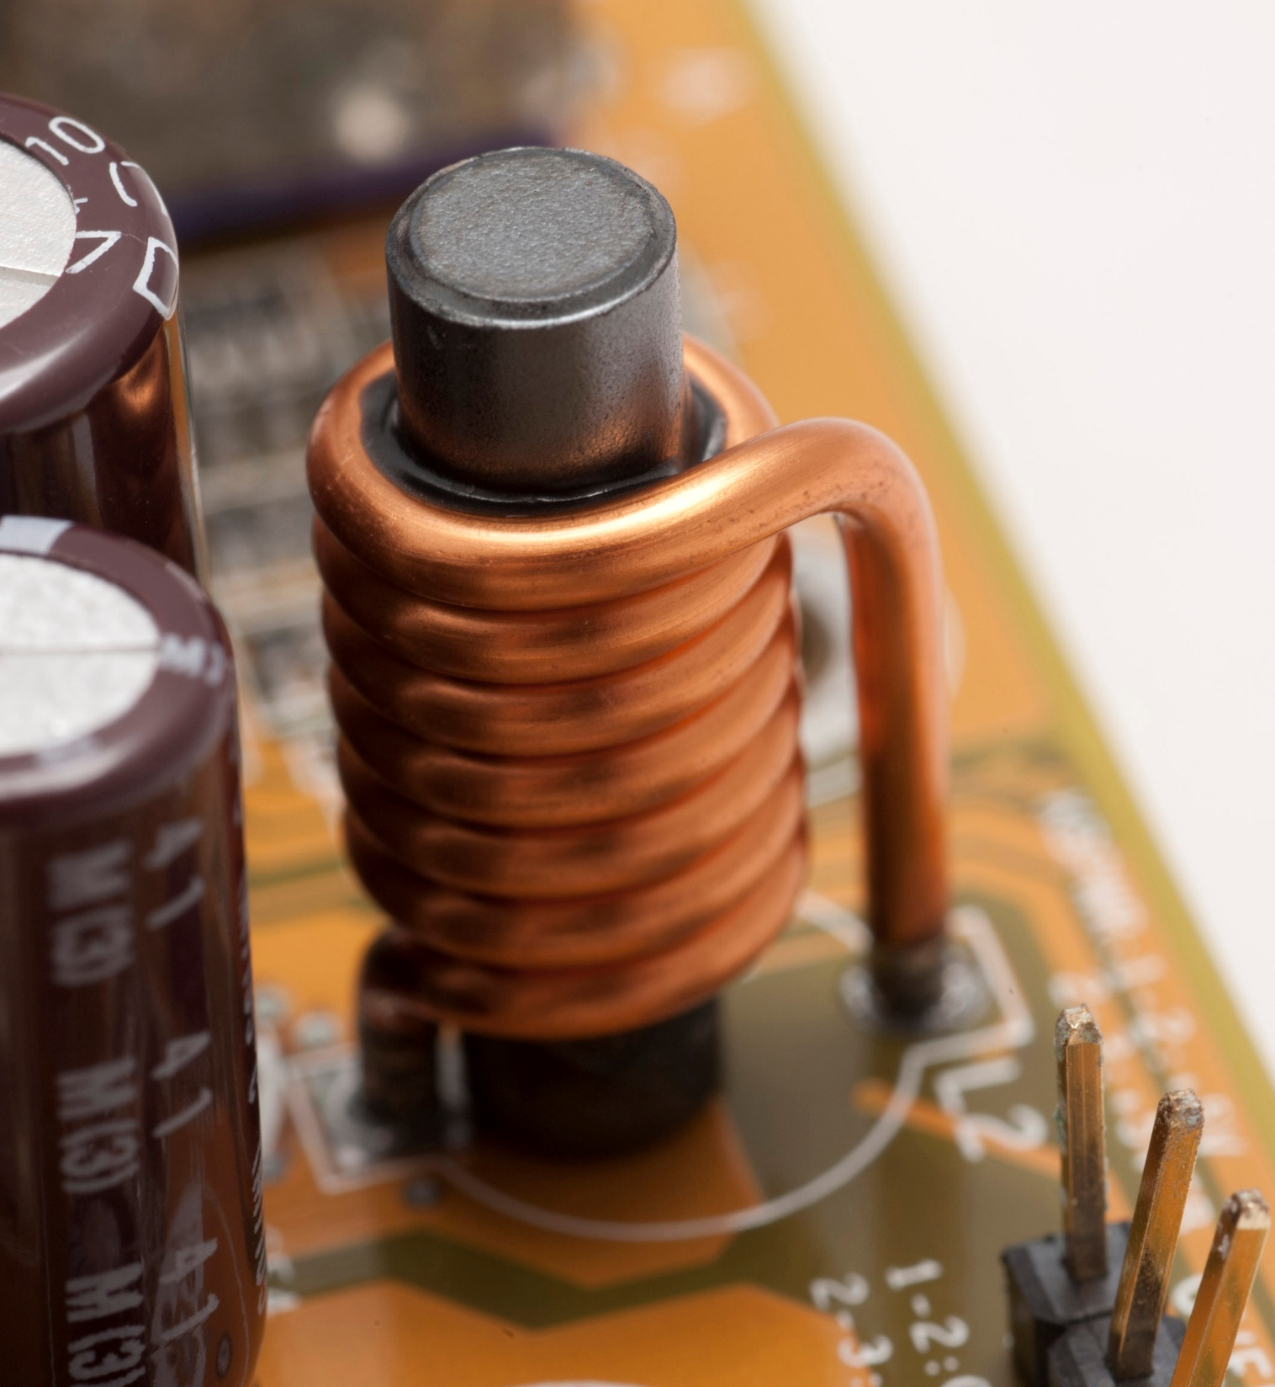
Back EMF
Two Magnetic fields fight each other
This Photo by Unknown Author is licensed under CC BY

Slide 16
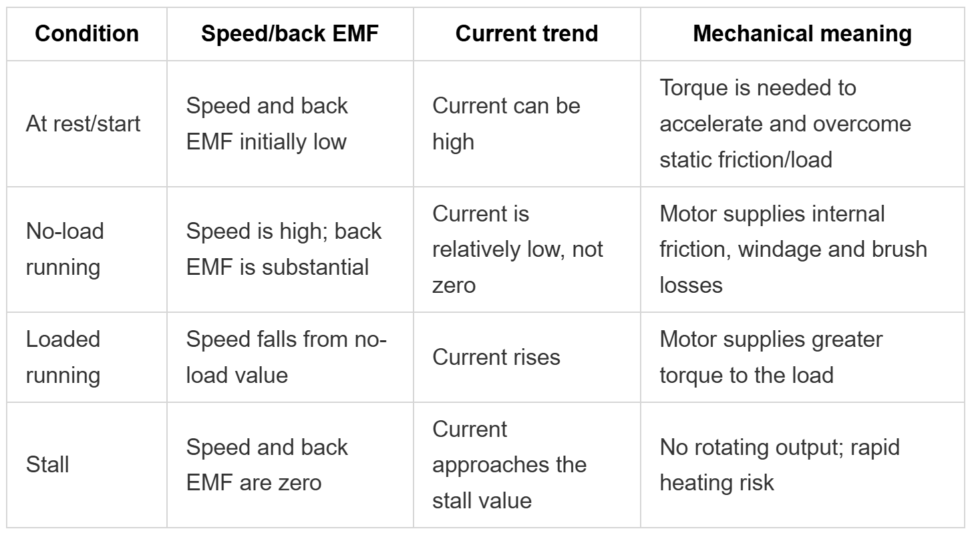
Startup, No Load and Stall
Notes:
Startup current is transient and depends on acceleration time, load, supply impedance and driver behaviour. Stall current is a specified or calculated zero-speed condition. They are related, but should not be presented as identical measurements in every system.

Slide 17

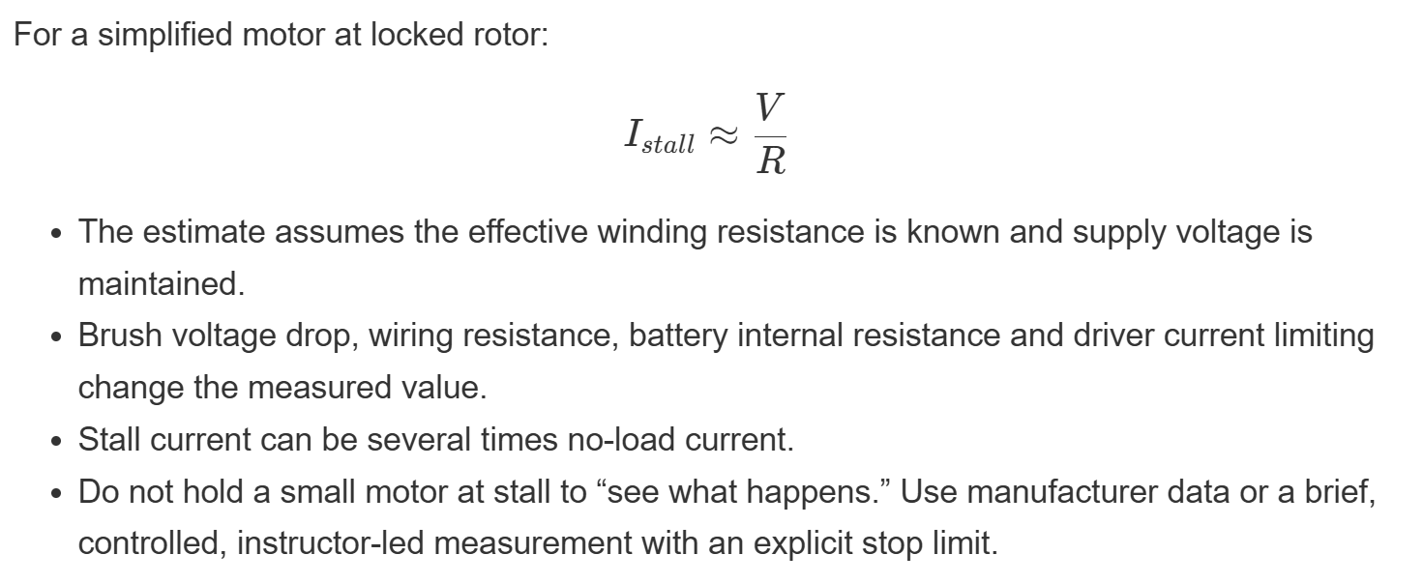
Estimating Stall Current Carefully
Notes:
Stall current is important for driver, wiring and supply selection, but not a normal operating target. Driver modules may have different continuous and short-duration peak ratings; both must be interpreted using the manufacturer's conditions.

Slide 18
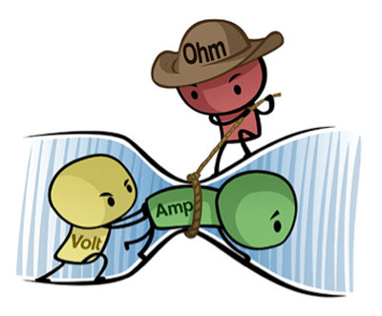

Slide 19
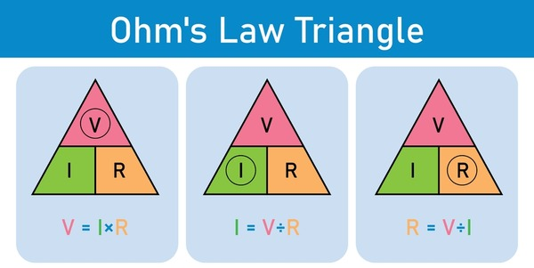

Slide 20
Voltage, Speed and Current
Increasing voltage generally increases speed.
At a given speed, more voltage can provide more current and torque margin.
Stall current rises approximately with voltage in the simplified resistance model.
Higher speed can increase friction, windage, commutation loss and mechanical stress.
Supply voltage under load may be lower than its open-circuit value because of internal resistance, wiring drop or current limiting.
Notes:
Do not imply that every motor follows a perfectly linear speed-voltage relationship at all loads. Use the data sheet and avoid operating above ratings unless the manufacturer provides an approved operating envelope.

Slide 21
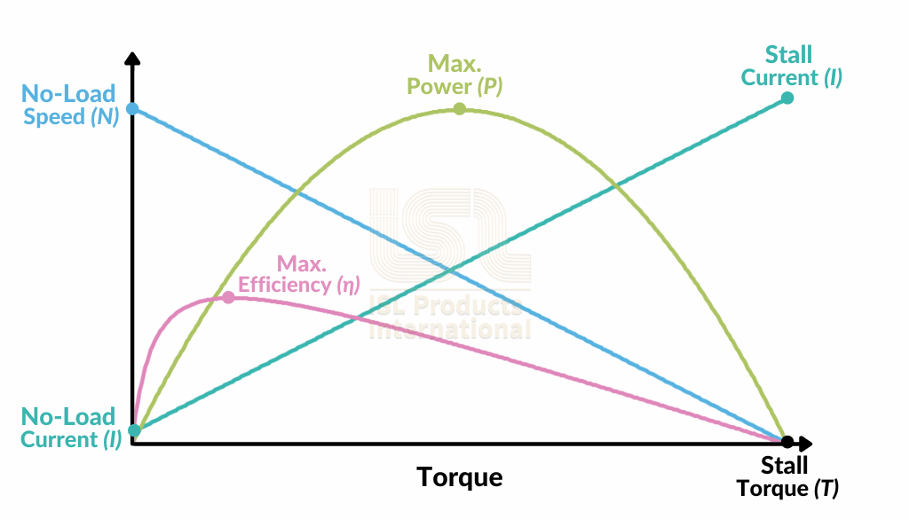

Slide 22
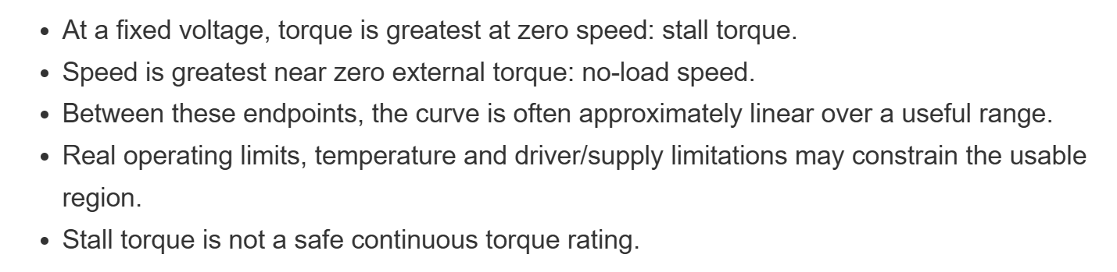
The Torque-Speed Curve
Notes:
Startup current is transient and depends on acceleration time, load, supply impedance and driver behaviour. Stall current is a specified or calculated zero-speed condition. They are related, but should not be presented as identical measurements in every system.

Slide 23
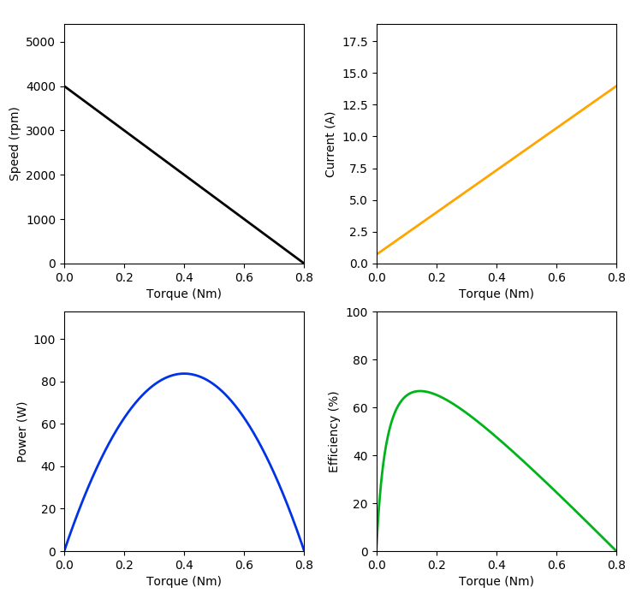
The Curves
Notes:
Identify both axes and units. Distinguish a manufacturer's measured curve from a theoretical straight-line approximation. If the data sheet has no continuous operating region, state that and use manufacturer guidance or testing rather than inventing one.

Slide 24
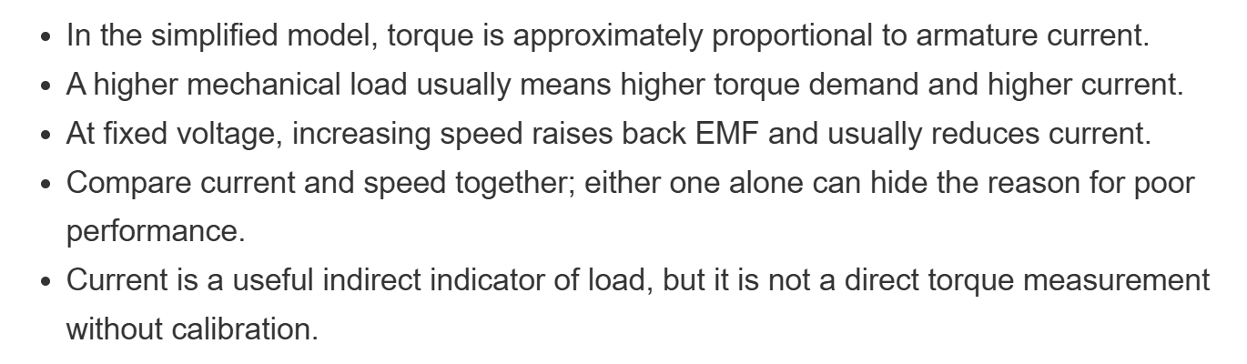
Current-Torque and Current-Speed Relationships
Notes:
Startup current is transient and depends on acceleration time, load, supply impedance and driver behaviour. Stall current is a specified or calculated zero-speed condition. They are related, but should not be presented as identical measurements in every system.

Slide 25

Read the Motor Data Sheet
Some suppliers provide only typical values, use different test conditions, or omit continuous thermal ratings. Record source, model and assumptions.

Slide 26

Wrap Up

Slide 27
Thank you
Questions?

